Slide 1

Real Time Hand Detection Algorithm for Kitchen Cobot
An Image Segmentation PCA Model
•Obada Albaba

Slide 2
Outline
Introduction and Background
Problem Statement
Data
Training
Testing and Implementation
Conclusions and Limitations
References

Slide 3
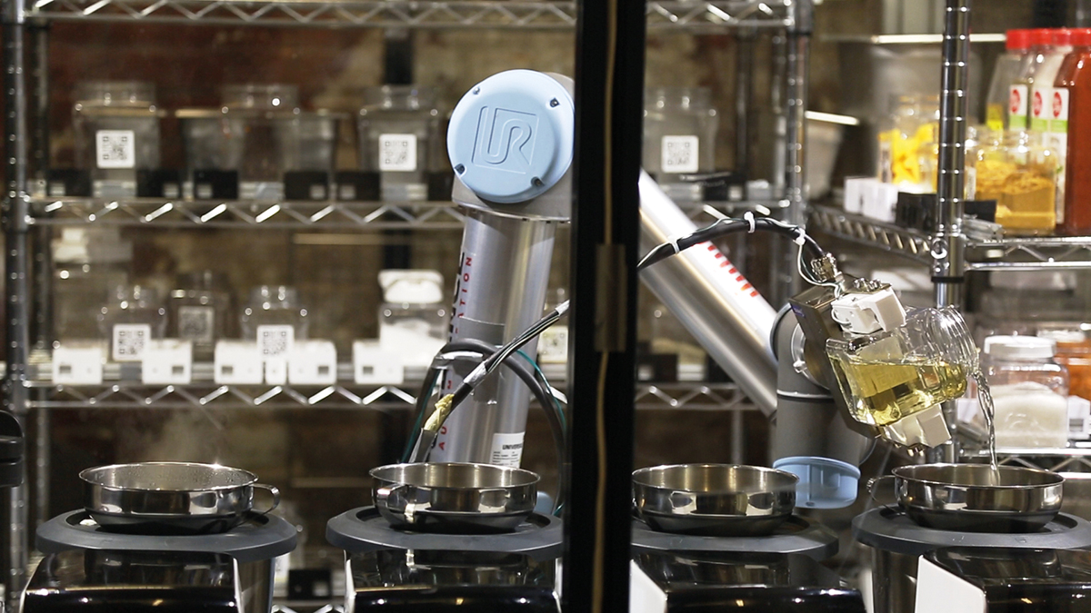
Collaborative Robots and Kitchen Automation
● Rapidly Growing Fields
● Key Drivers for growth:
Demand for Quality Foods
Limitations in Labour
Advancements in ML and CV
Notes:
Fuel Efficiency requirements: government legislation?

Slide 4
Background
● Automated Kitchen Environment:
Relies on robotic arm to accomplish repetitive tasks with accurate timing
Human Intervention often required
● Challenges:
Robot arm can hurt operator
Safe mode slows down cooking process
Safe mode leads to suboptimal results due to timing limitations
Notes:
Motors types used: interior permanent magnet synchronous machines (IPMSM) induction machine (1M)
Advantage: This class of machines has two major advantages over the induction machine (1M), which can be considered to be the second most commonly used machine in this type of application.
Being able to have strong estimators for the rotor temperature helps the automotive industry to manufacture motors with less material and enables control strategies to utilize the motor to its maximum capability. A precise torque estimate leads to more accurate and adequate control of the motor, reducing power losses and eventually heat build-up.As the temperature has direct impact on the remanent flux density of the magnet material monitoring its temperature also helps to increase the accuracy of the estimated torque [1].
Direct measurement of the permanent magnet temperature is in most cases not economically reasonable, as information has to be passed over from rotor to stator preferably via some kind of wireless technology.

Slide 5
The problem
Client
Context
Problem statement
Automated Kitchen Developer (rapidly growing Startup).
Robotic arm used in kitchen environment needs to run at full capacity and avoid human to achieve optimal results safely.
Use Latent Variable Analysis techniques to develop an image segmentation model.
Notes:
Industry:
Current Market size:
Growth rate: 28% [o2]
Key Drivers for growth: the need for fuel efficient and low-emission vehicles
Context:
Motors types used: interior permanent magnet synchronous machines (IPMSM) induction machine (1M)
Advantage: This class of machines has two major advantages over the induction machine (1M), which can be considered to be the second most commonly used machine in this type of application.
Motivation: As the temperature has direct impact on the remanent flux density of the magnet material monitoring its temperature also helps to increase the accuracy of the estimated torque
Direct measurement of the permanent magnet temperature is in most cases not economically reasonable, as information has to be passed over from rotor to stator preferably via some kind of wireless technology.
Problem statement:
Are there any easily measured variables that can be used to predict rotor temperature? Voltage, current, coolant temperature, etc?

Slide 6
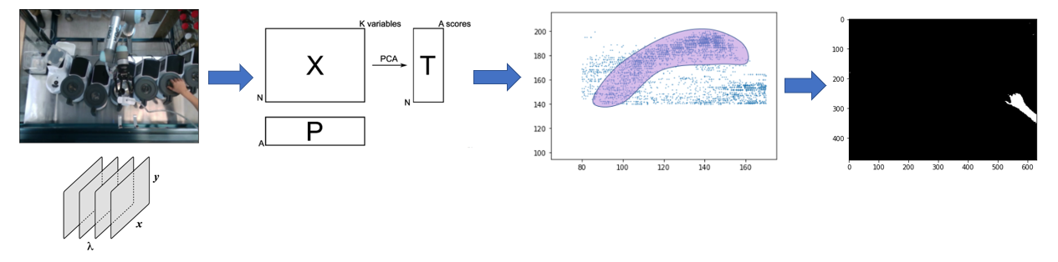
Methodology
● Obtaining the necessary data from Workspace Monitoring Camera
● Data Manipulation and Normalization
● PCA Analysis (Training the model)
● Test model using multiple images/video
● Presentation and automation
Notes:
The dataset comprises several sensor data collected from a permanent magnet synchronous motor (PMSM) deployed on a test bench. The PMSM represents a German OEM's prototype model. Test bench measurements were collected by the LEA department at Paderborn University. This dataset is mildly anonymized.

Slide 7
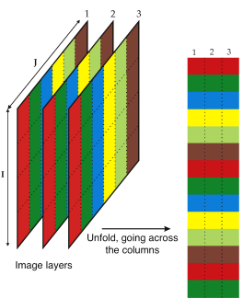
Retrieving and Preparing Data
The dataset comprises of Camera footage from a camera placed above workspace.
Representative image is taken out from video and modeled as RGB 3D Array.
Numpy library is used to unfold the Array and form and X matrix.

Slide 8
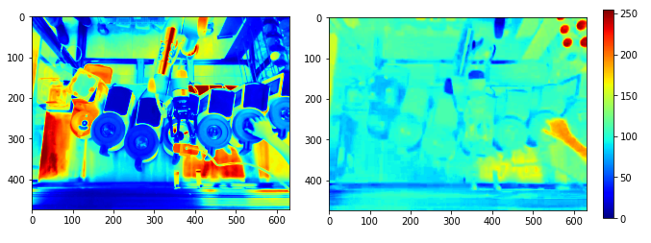
PCA
Utilize PCA modeling function built into Sklearn Python Library.
Plot the t1 and t2 scores as images by folding the arrays into image matrices.
Notice that the pixels that represent the hand fall within a certain range of t2 and t2 score values.

Slide 9
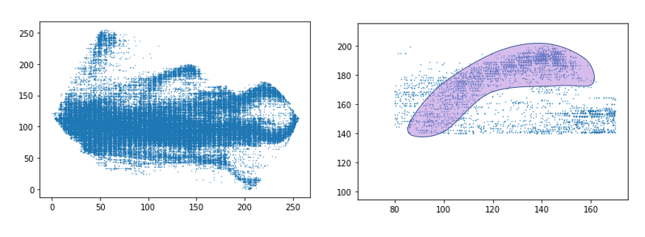
PCA
Create the t1 vs t2 to notice clusters
We notice an airfoil shaped cluster that falls within the ranges of t1 and t2 seen in t1 and t2 images

Slide 10
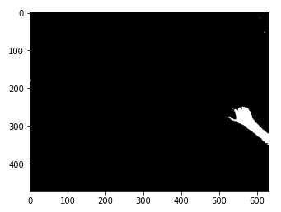
Image Segmentation
We finally apply the filters on the image
Assign a value of 1 to pixels that satisfy t1 & t2 conditions and 0 to the rest of the pixels

Slide 11
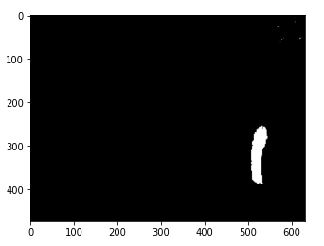
Creating the Model and Testing
Retrieve loadings matrix P used to create T in training phase.
Transform instantaneous image data into an X matrix.
Perform matrix multiplication to obtain T_{i} = X x P
Apply filtering algorithm to exclude pixels outside of desire range of t1 & t2 (spectral characteristics).

Slide 12
Implementation for Real-time Application
Simplified model is used that uses simple matrix multiplication and thresholding
Use openCV library to read webcam footage
Identify location and angle of human arm using pixel locations

Slide 13
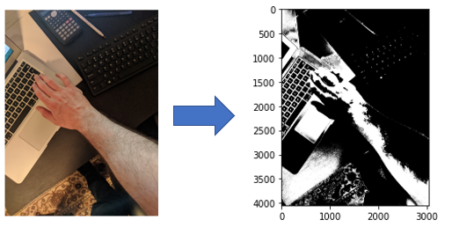
Limitations
● Spectral characteristics are used to train the model
● Model is sensitive to lighting conditions
● Surrounding environment impacts model performance

Slide 14
Conclusion
Performing PCA on image data provides a robust image segmentation model
The first two components are useful whilst the third component mainly explains noise
Training conditions such as lighting need to be maintained for accurate use of model

Slide 15
Further Research
Training on multiple images
Model retraining can be performed periodically to account for changes in lighting and surroundings

